Slide 1

Network Intrusion Detection System

Slide 2

Supervised by Dr.Maggie Ezzat
German University in Cairo
Presented by :
Nourhan Reda Abdellal
Khaled Badr El Toukhy
Nardeen Shaher Abdo

Slide 3

Presentation outline:
Introduction
Data exploration
Data preprocessing
Handling class imbalance
Binary classification
Multi classification

Slide 4
Intro to Intrusion Detection Systems

Slide 5
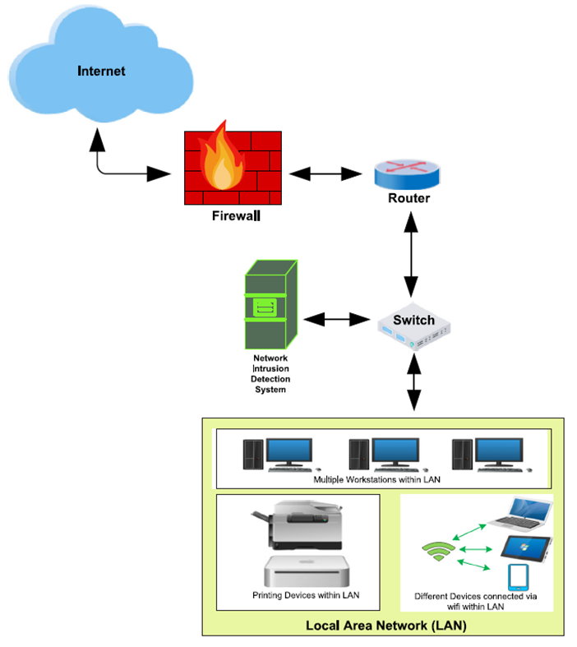
Abstract
Network intrusion detection systems (NIDS) are the most common tool used to detect malicious attacks on a network. They help prevent the ever-increasing different attacks and provide better security for the network.
•NIDS is implemented in the form of a device or software that monitors all traffic passing through a strategic point in the network for malicious activities.

Slide 6
Goals of NIDS
•The main goals of NIDS include:
1.Analyzing a wide variety of intrusions.
2.Detect intrusions in timely fashion.
3.Present the analysis in a simple, easy-to-understand format.
4. High accuracy in detection

Slide 7
NIDS with Machine Learning
• Enormous increase in network traffic in recent years and the resulting security threats are posing many challenges for detecting malicious network intrusions.
• To address these challenges, ML and DL-based NIDS have been implemented for detecting network intrusions.
• Anomaly detection has been the main focus of these methods, due to the potential for detecting new types of attacks.

Slide 8
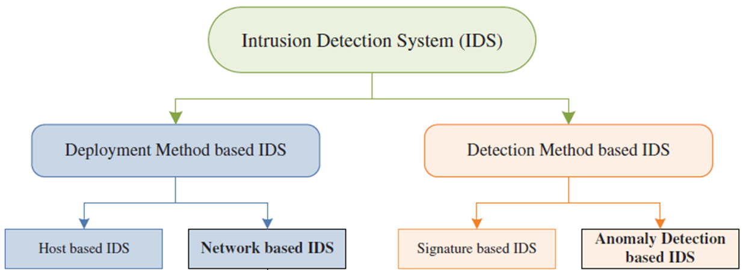
NIDS with Machine Learning
Machine learning models that applied :
Logistic regression
Random forest
XG-Boost

Slide 9
Data Exploration

Slide 10
Dataset Description
Due to the complexity in obtaining real-world labelled benign and attack network flows, researchers have generated benchmark NIDS datasets. They are made publicly available to be used in the training and testing stages of the proposed ML detection model.
This dataset reflect real network benign behavior combined with synthetic attack scenarios .
Our data is used by University of Queensland, Brisbane QLD 4072, Australia and University of New South Wales, Canberra ACT 2612, Australia
And this data is a subset of big data used , the big data has many data sets inside it , and this data is one type of it t's called NF-Ton-IoT, Its about 1,379,274 and 14 feature.

Slide 11
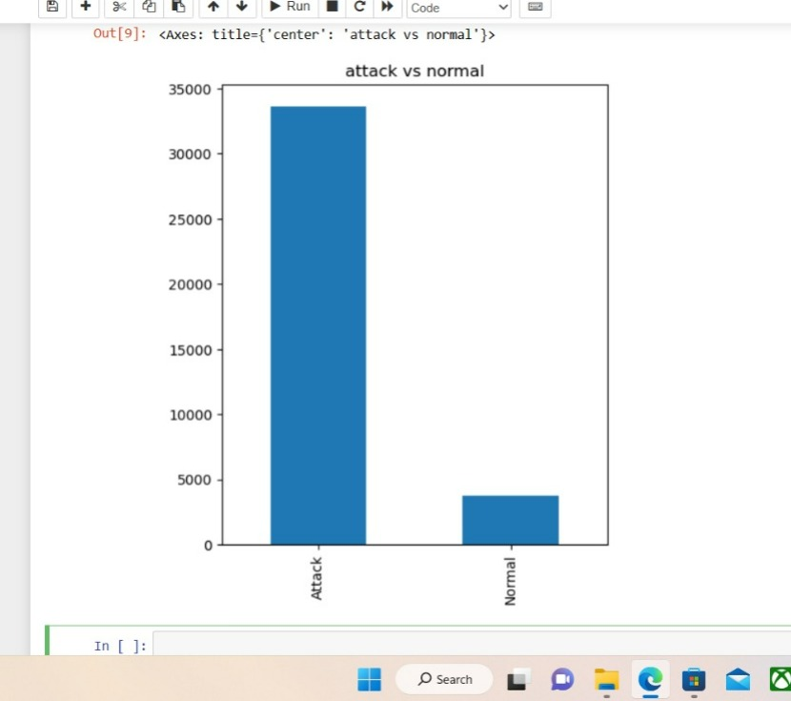
Dataset Description
NF-ToN-IoT- A recent heterogeneous dataset released in 2020 that includes telemetry data of Internet of Things (IoT) services, network traffic of IoT networks and operating system logs. In this paper, we utilize the portion containing network traffic flows. The dataset is made up of a large number of attack scenarios conducted in a realistic representation of a medium-scale network at the Cyber Range Lab by ACCS.
The total number of data flows is 1,379,274 out of which 1,108,995 (80.4%) are attack samples and 270,279(19.6%) are benign ones, the table below lists and defines the distribution of the NF-ToN-IoT dataset.

Slide 12
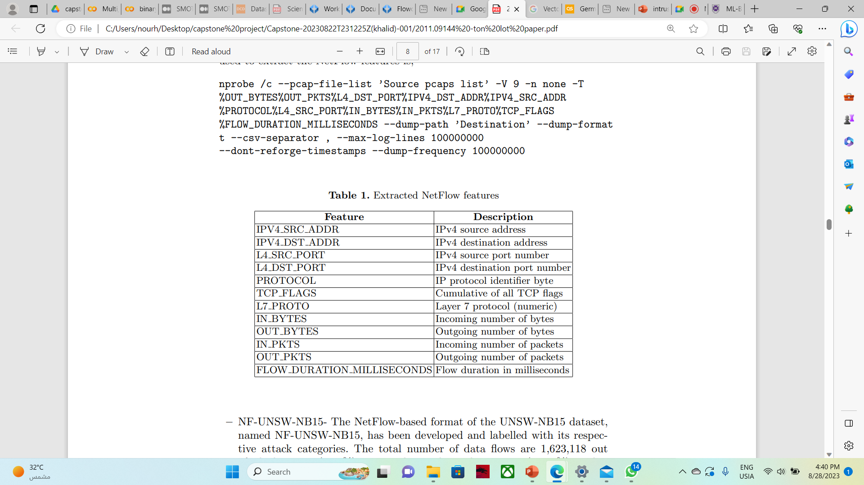
Feature Description

Slide 13
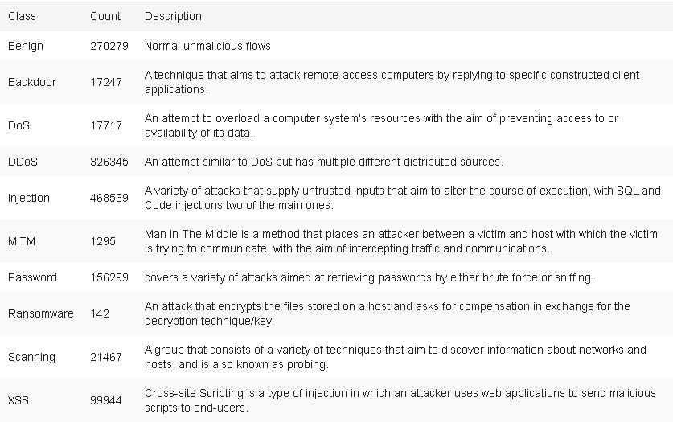
Feature Description

Slide 14
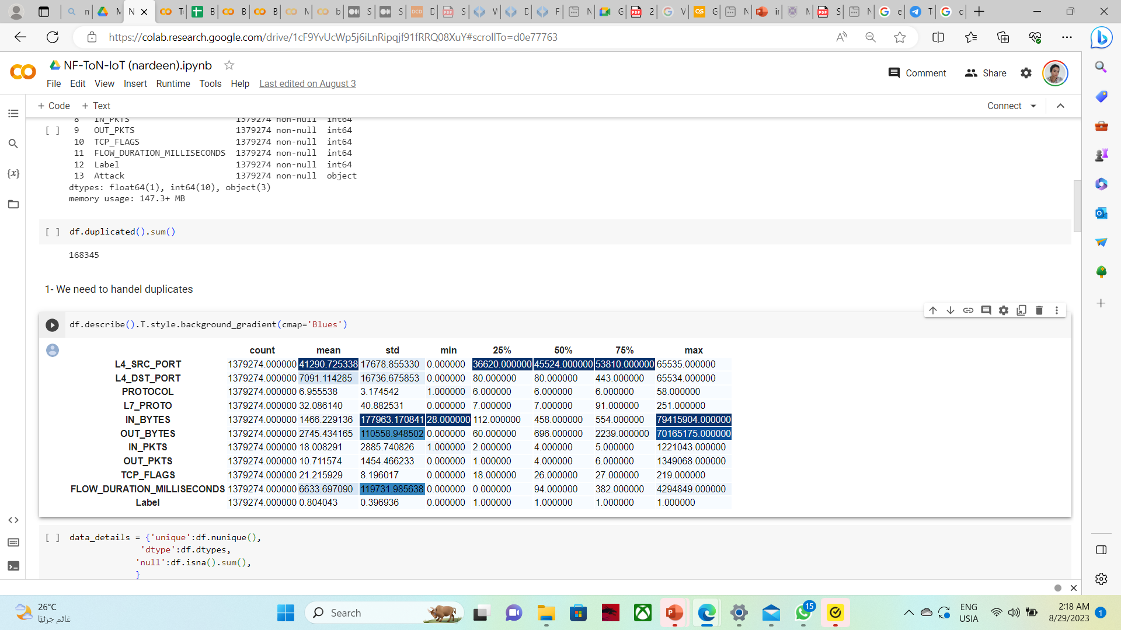
Feature Descriptions
The table below lists and defines the description the insights of the NF-ToN-IoT dataset.

Slide 15
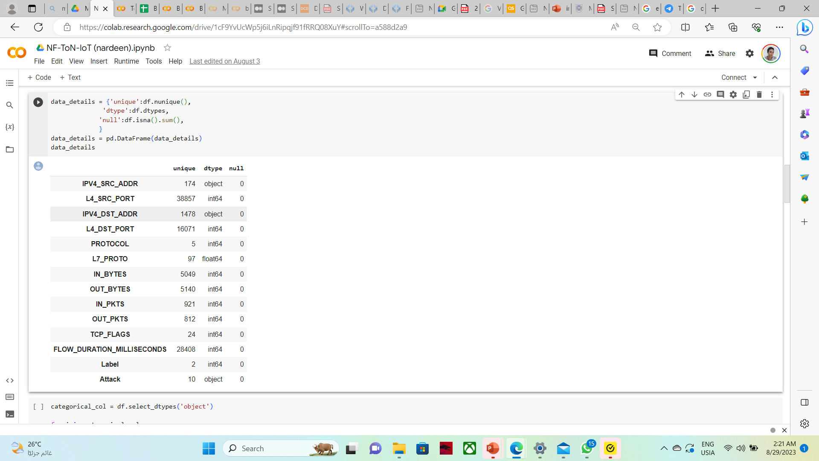
Feature Descriptions

Slide 16
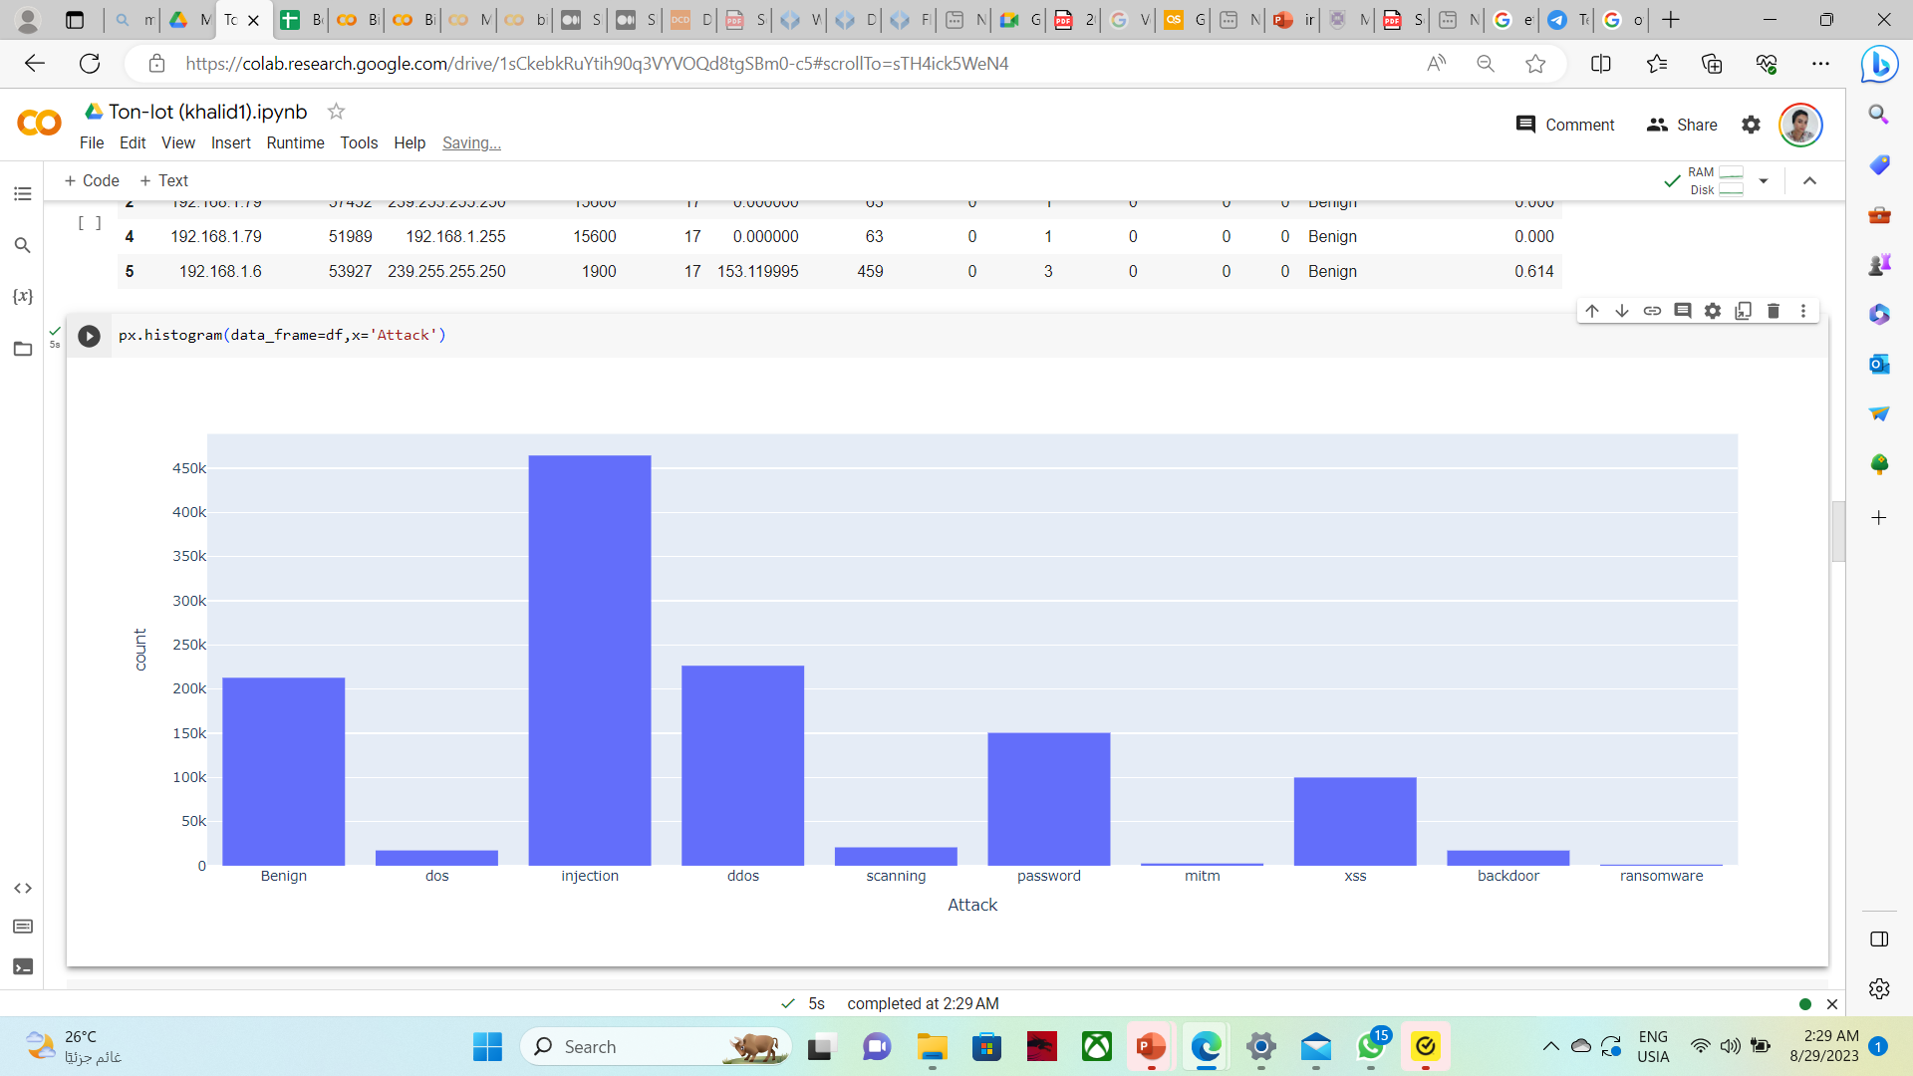
Feature Descriptions
the table below shows the number of each attack type in this Data set

Slide 17
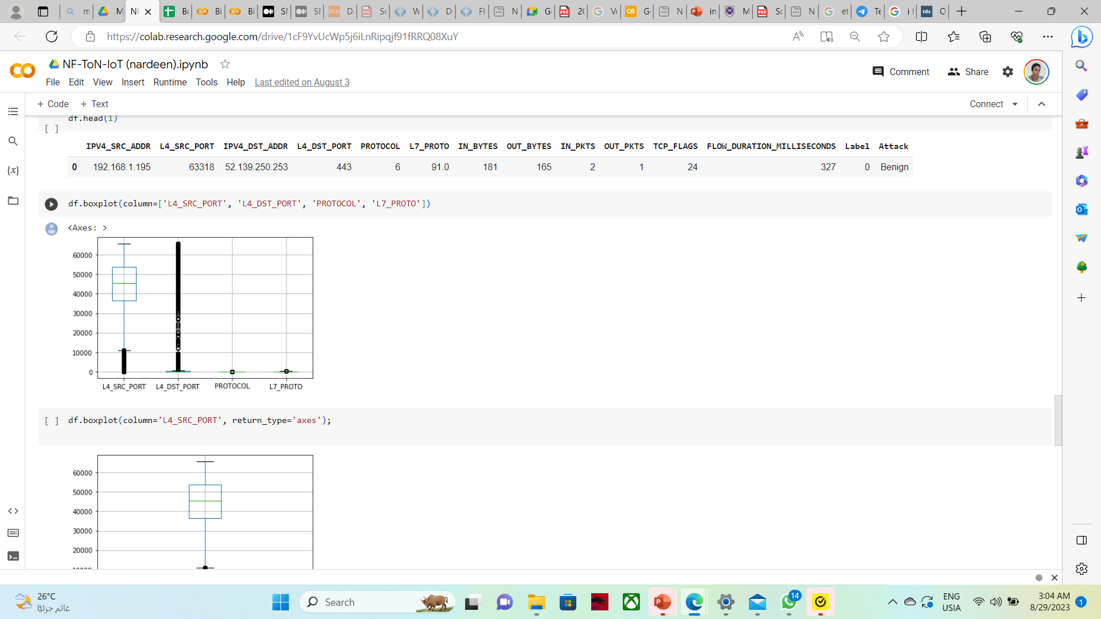
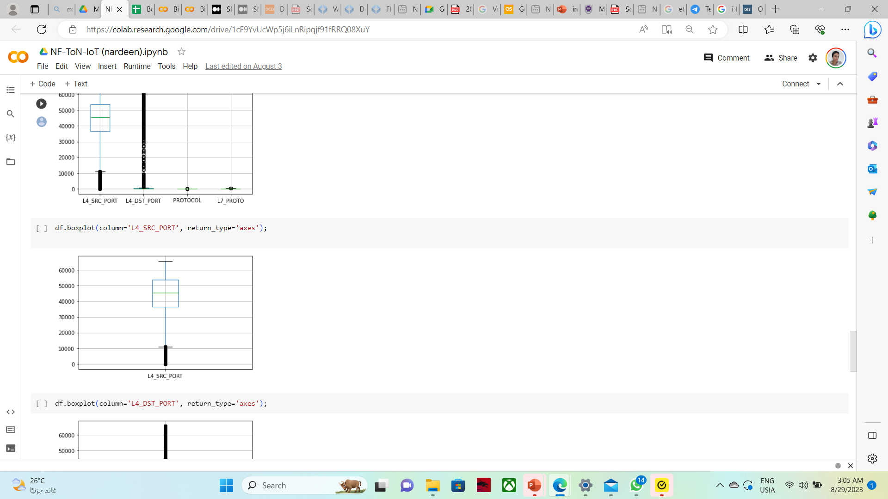
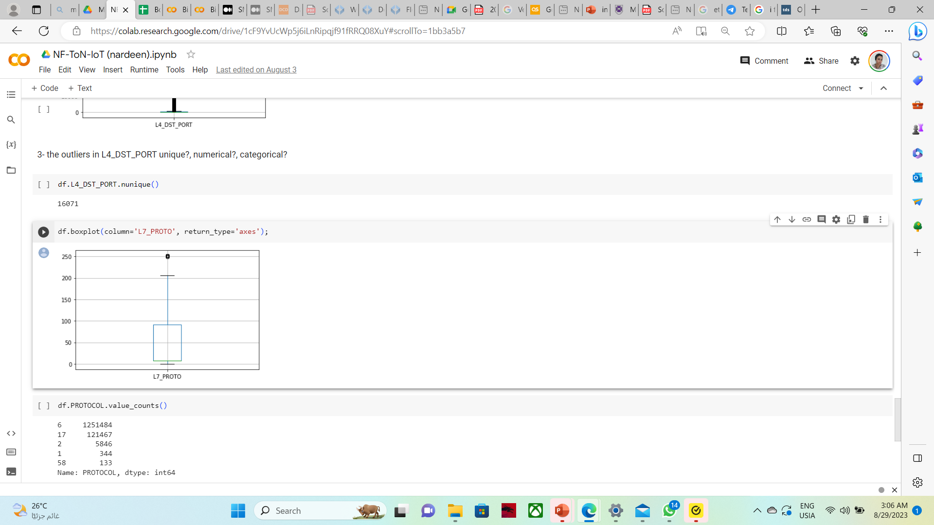
Feature Descriptions (outliers)
The table below shows the outliers

Slide 18
Data preprocessing

Slide 19
Data Preprocessing(Duplicates)
After exploring the duplicates in the dataset with pandas it calculated number of duplicates of 168,344.
Most of them were complete duplicates that needed to be removed.
And the others that wasn’t complete duplicates we decided to keep them to ensure no information loss.

Slide 20
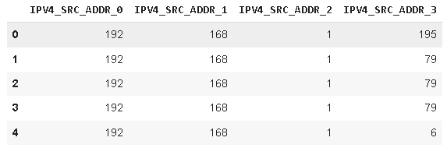
Data preprocessing (splitting IP address)
Some features like 'IPV4_SRC_ADDR' and 'IPV4_DST_ADDR' types are string in the original data , and the research made by Queensland university they drop these features, but here in this research it's preferred to split these field each into 4 columns so we can be deployed at ML ,especially the IP addresses are not unique and a lot are repeated.

Slide 21
Data preprocessing
Before using the data for the machine learning model, data preprocessing is essential to make it understandable and learnable by the model. The NF-TON-IOT dataset is a clean dataset without any empty or Not a Number (NaN) entries.
As for data engineering processes the data types should be fitted to the actual data, and if must try to lower the computational memory of the observation.
We have used a technique to reduce the integers and floats dtypes to lower the memory usage, and all the categorical features were set to category dtype.
In principle, outliers are less frequent than regular observations (less than 5%)and are different from them in terms of values (they lie further away from the regular observations in the feature space). That is why by using such random partitioning they should be identified closer to the root of the tree (shorter average path length, i.e., the number of edges an observation must pass in the tree going from the root to the terminal node), with fewer splits necessary.
Isolation forest technique is used to handle the outliers hoping no data loss.

Slide 22
Data preprocessing
After applying the Isolation forest Algorithm it turns out that the number of outliers for all multivariate data are 140 observations.
Referring to the high variance of data it was concluded that most of the outliers points were not actual outliers, but it had to be analyzed and included in the training process of the ML model.

Slide 23
Addressing the class imbalance problem in network intrusion detection systems using data resampling
When a class is underrepresented in a dataset, this causes the dataset to be imbalanced. Detecting the minority class becomes a difficulty which lowers the performance of the intrusion detection system.
The NF-TON-IOT dataset has much more attack samples than the normal samples.
Techniques used to handle class imbalance:
Random oversampling
Smote
Adasyn

Slide 24
ML model preparation
Encoding
ML learning models only understand numeric values, that’s why the nonnumeric attributes have to be encoded in some way to be understood by the model.
Label Encoding
it is a technique that is used to convert categorical columns into numerical ones so that they can be fitted by machine learning models which only take numerical data. It is an important pre-processing step in a machine-learning project.
Get dummies is applied on ['PROTOCOL','TCP_FLAGS’] as it's categorical and as
pandas.get_dummies() is used for data manipulation. It converts categorical data into dummy or indicator variables.

Slide 25
ML model preparation
Normalization:
Two techniques were used In normalization
Standardization with Standard Scaler
Normalization using Minmax scaler
Splitting the data:
After applying encoding and normalization on the dataset, we have divided the whole data set into train and test parts with percentages of 75% and 25% respectively.
Then we have applied GridSearchCV and RandomizedSearchCV to cross validate the data which was set to five cv=5, which also maintains shuffling of the data to ensure that every sample of he data gets the same ratio of every attack label.

Slide 26
Binary-Class Classification

Slide 27
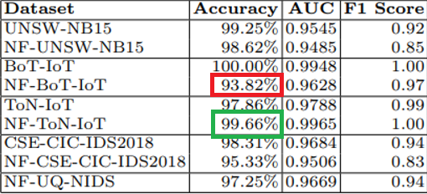
In this experiment, we evaluate the attack detection performance of the NetFlow datasets compared to the NF-TON-IOT. This table lists the accuracy, AUC, F1 score.
According to the queens land scientific paper The NF-ToN-IoT’s dataset performance was superior to its other data sets of the same branch of TON-IOT, achieving a 99.67% accuracies as shown
The table below shows the accuracy of different data sets and NF of these data sets

Slide 28
So ,in our research we apply different machine learning models on the NF-TON-IOT dataset with applying different sampling techniques.
Those ML models are applied on:
No over sampled data
Random over sampled data
SMOTE sampled data
ADASYN sampled data
The below table shows the accuracy score with splitting data into 75% train and 25% test
binary-class classification data splitting on 25% | Logistic regression | Random forest | XG-boost
No over sampled data | 0.9902 | 0.9998 | 0.999
Random over sampled | 0.9844 | 0.9999 | 0.9999
smote over sampled | 0.9852 | 0.9999 | 1.0
Adasyn over sampled | 0.9999 | 0.9999 | 0.9997

Slide 29
The table shown is the result of applying ML model at the data with K-fold cross validation
cross validation cv=5 | logistic regression | Random forest | XG-boost
No over sampled data | 0.99910 | 0.9998 | 0.99997
Random over sampled | 0.985 | 1 | 1
smote over sampled | 0.9955 | 0.999 | 0.999
Adasyn over sampled | 1.0 | 1.0 | 0.999
The results are improves very well on applying over sampling techniques to give 100% precision and recall in the binary classification.
As we tested the data with k-fold validation (cv=5) and the data accuracies are slightly improved.

Slide 30
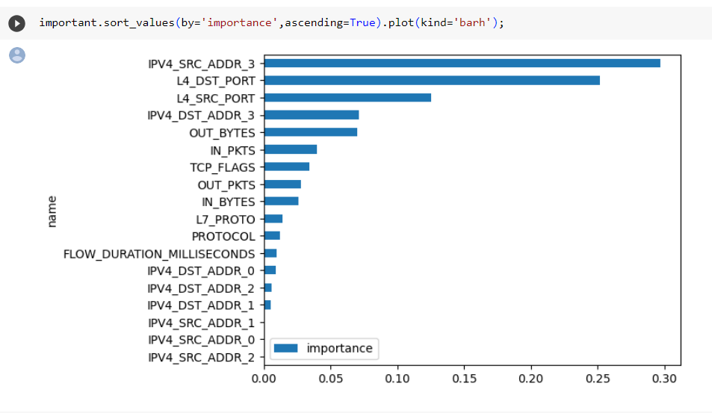
Feature importance
These are feature impotances of the Random Forest model in binary class and how is the importances are distributed among the features.

Slide 31
Multi-Class Classification

Slide 32
Dropping normal traffic In the case of multi-class classification, the normal traffic is dropped from both the train and test datasets. This is implemented to let the model focus more on classifying the attack type without confusing it with a normal sample. This is done under the assumption of having two-stage NIDS which will first identify an attack then identify its type. The distribution of the dataset samples after dropping normal traffic .
We have built our ML models in four stages of data samplers:
No over sampled data
Random over sampled data
SMOTE sampled data
ADAYSN sampled data
Also PCA technique is applied to SMOTE and ADASYN data to view different accuracies comparison.

Slide 33
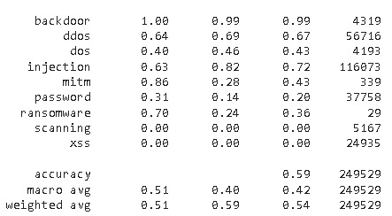
No-over-sampler
At logistic regression algorithm with NO oversampled data the percentage of classes are 59%
Logistic regression with NO over sampler

Slide 34
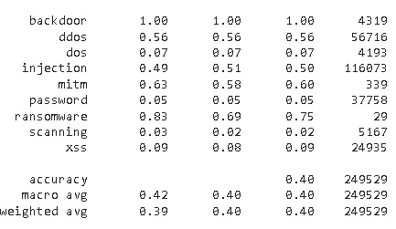
No-over-sampler
At Random-Forest algorithm with NO oversampled data the percentage of classes are 40% accuracy
Random Forest with NO over sampler

Slide 35
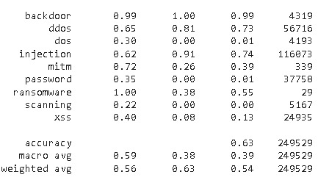
No-over-sampler
Gradient-boost with NO oversampled data the percentage of classes are accuracy 63%
Gradient Boost with NO over sampler

Slide 36
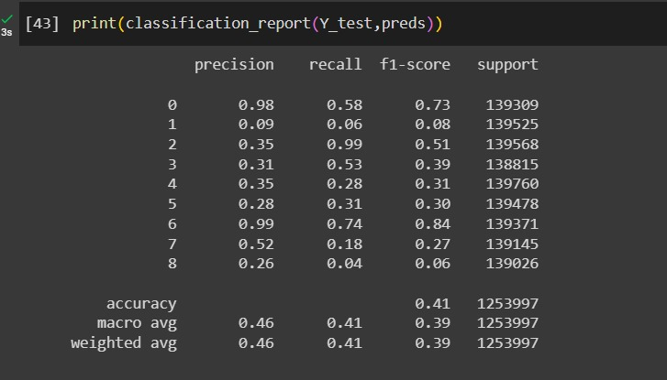
SMOTE-sampler
Logistic regression with SMOTE oversampled data the percentage of classes are accuracy 41%
Logistic regression SMOTE over sampler

Slide 37
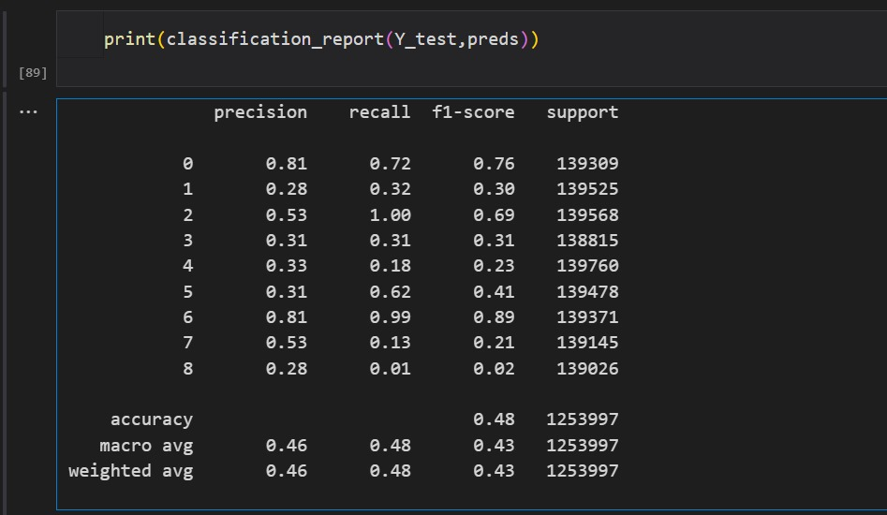
SMOTE-sampler with PCA
Logistic regression with SMOTE oversampled data and PCA the percentage of classes are accuracy 48% slightly improved compared to original SMOTE 41%
Logistic regression SMOTE over sampler and PCA

Slide 38
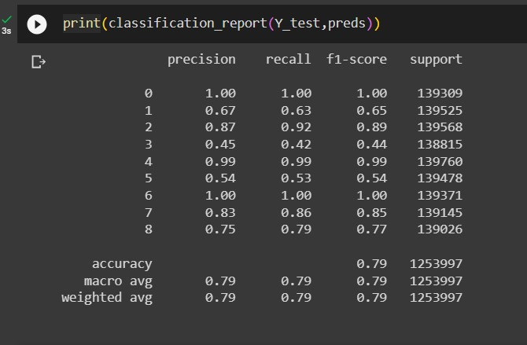
SMOTE-sampler
Random forest with SMOTE oversampled data the percentage of classes are accuracy79%
Random-Forest SMOTE over sampler

Slide 39
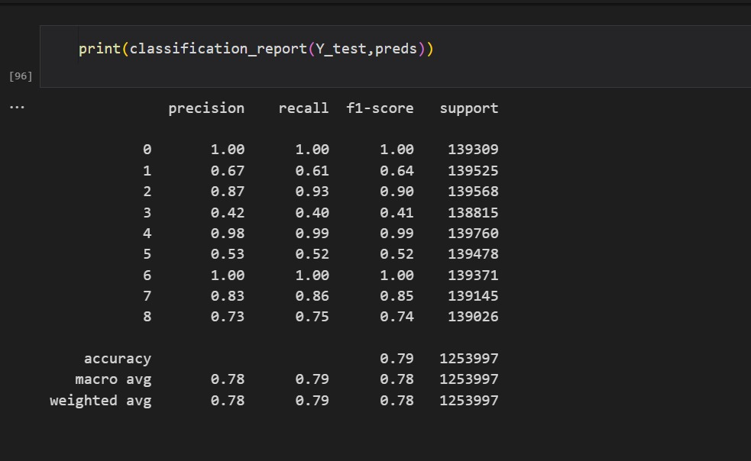
SMOTE-sampler with PCA
Random forest with SMOTE oversampled data with PCA the percentage of classes are accuracy 79% and it's the same without PCA
Random-Forest SMOTE over sampler with PCA

Slide 40
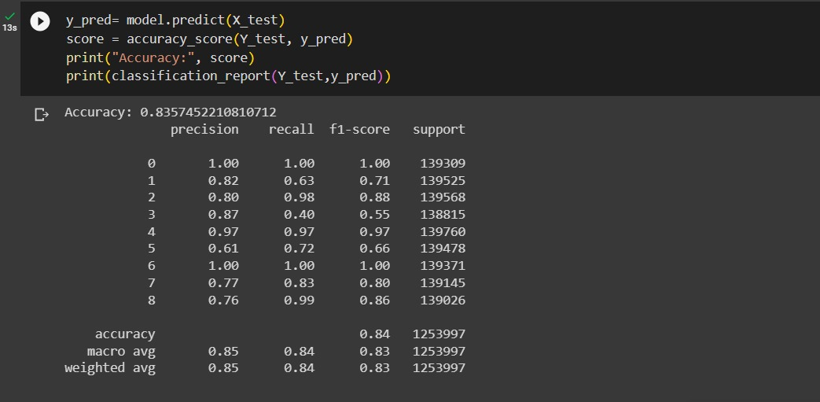
SMOTE-sampler
CAT-BOOST with SMOTE oversampled data the percentage of classes are accuracy 84%
Cat-Boost regression SMOTE over sampler

Slide 41
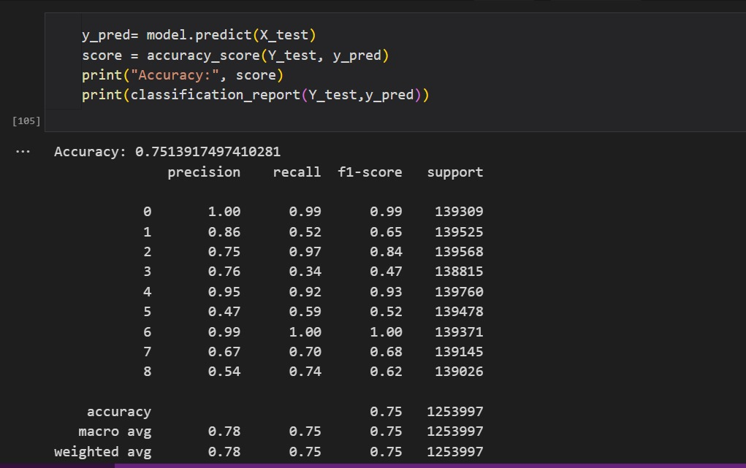
SMOTE-sampler with PCA
CAT-BOOST with SMOTE oversampled data with PCA the percentage of classes are accuracy 75 % and it's worst than without PCA 84%
Cat-Boost regression SMOTE over sampler

Slide 42
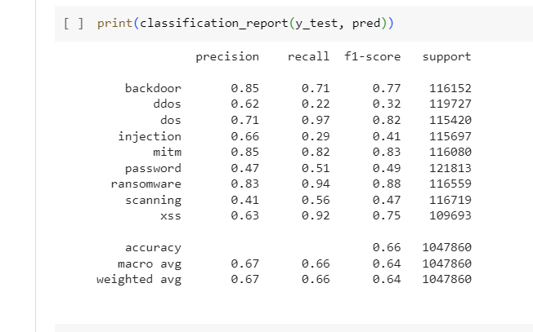
ADASYN over-sampler
At logistic regression algorithm with ADASYN the percentage of classes are slightly improved it gives 65% rather than 59% with no over sampled data
Logistic regression with ADAYSN over sampler

Slide 43
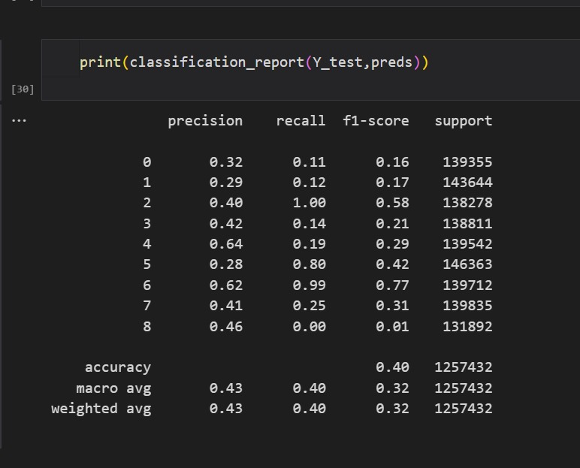
ADASYN over-sampler with PCA
Logistic regression with ADASYN after applying PCA the percentage of classes didn’t improve it gives accuracy 40% rather than ADAYSN alone 65%
Logistic regression with ADYSN over sampler after applying PCA

Slide 44
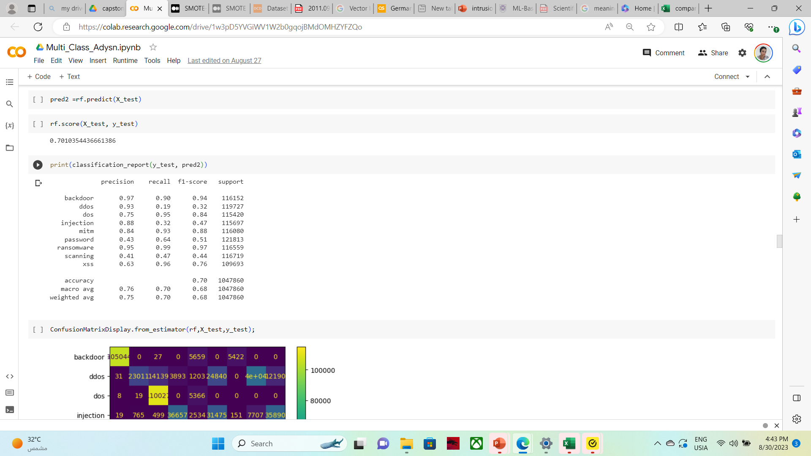
ADASYN over-sampler
At Random Forest algorithm with ADASYN the percentage of classes are slightly improved, it gives 70% rather than 40% with no over sampled data
Random Forest with ADAYSN over sampler

Slide 45
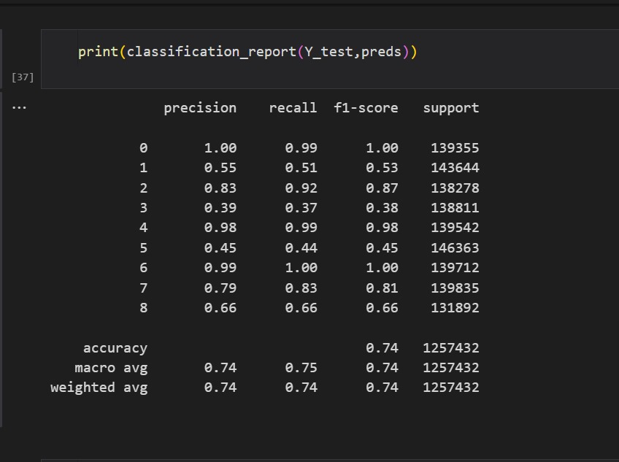
ADASYN over-sampler with PCA
Random Forest with ADASYN after applying PCA the percentage of classes are improved it gives accuracy 74% rather than ADAYSN alone 70%
Random forest with ADAYSN over sampler after applying PCA

Slide 46
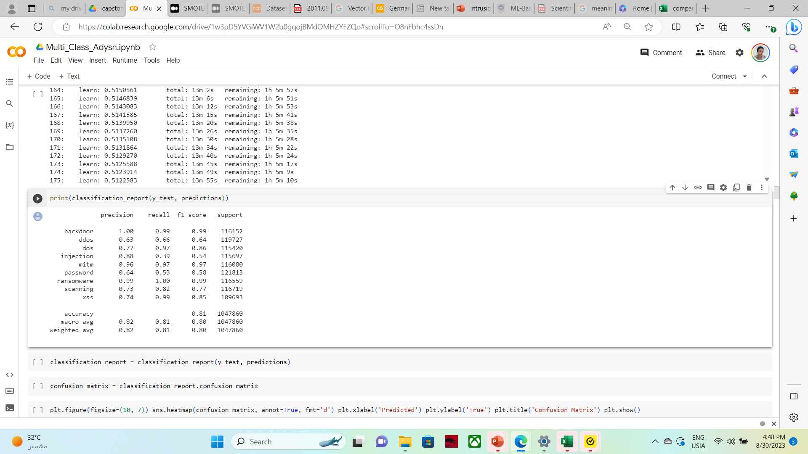
ADASYN over-sampler
CAT_BOOST with ADASYN the percentage of classes are strong improved it gives 81%
CAT-BOOST with ADAYSN over sampler

Slide 47
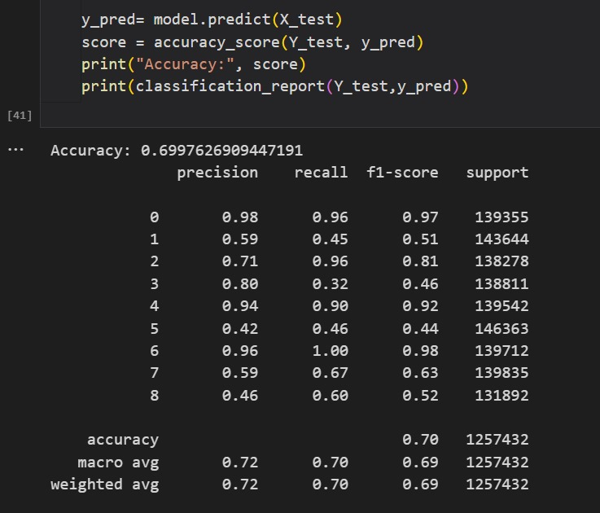
ADASYN over-sampler with PCA
CAT-BOOST after applying PCA the percentage of classes doesn’t improved it gives accuracy 70% rather than ADASYN alone 81%
CAT-BOOST with ADASYN over sampler after applying PCA

Slide 48
It's noticed that the best machine learning algorithm is CAT-BOOST after applying SMOTE over-sampling by accuracy 84%
data splitting on 25% | logistic regression | Random forest | XG-boost
No over sampled data | 0.59 | 0.401 | 0.63
SMOTE over sampled | 0.41 | 0.79 | 0.84
ADAYSN over sampled | 0.6579 | 0.701 | 0.8103
Results on applying PCA with SMOTE and ADAYSN over sampler
multi-class classification with PCA data splitting on 25% | logistic regression | Random forest | XG-BOOST
SMOTE over sampled | 0.48 | 0.79 | 0.75
ADAYSN over sampled | 0.4 | 0.74 | 0.7

Slide 49
Links to our dataset and references:
Queens Land University dataset: https://staff.itee.uq.edu.au/marius/NIDS_datasets/
. Claise, B., Sadasivan, G., Valluri, V., Djernaes, M.: Cisco systems NetFlow services export version 9 (2004)
. Mustafa, N.: Ton-Iot datasets (2019). https://doi.org/10.21227/fesz-dm97, http://dx.doi.org/10.21227/fesz-dm97
Cisco Systems: Cisco IOS NetFlow Version 9 Flow-Record Format - White Paper. https://www.cisco.com/en/US/technologies/tk648/tk362/technologies_ white_paper09186a00800a3db9.pdf (2011
Shiravi, A., Shiravi, H., Tavallaee, M., Ghorbani, A.A.: Toward developing a systematic approach to generate benchmark datasets for intrusion detection. Computers & Security 31(3), 357 – 374 (2012). https://doi.org/https://doi.org/10.1016/j.cose.2011.12.012, http://www.sciencedirect.com/science/article/pii/S0167404811001672

Slide 50

Thank you very much

